Slide 1
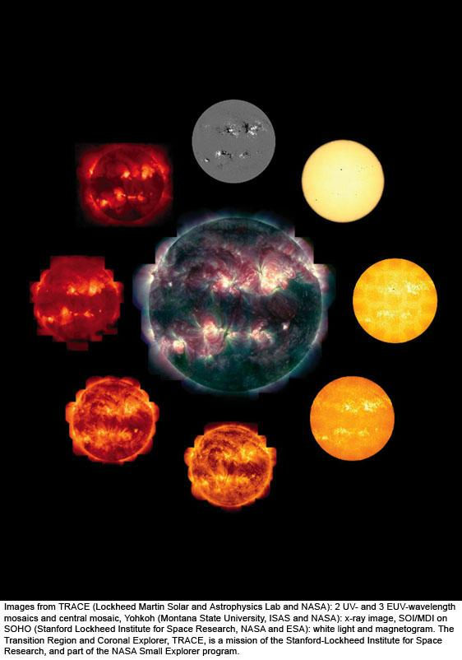
a
© Gerard Williger 2023 U Louisville
Lec 5: The Sun
Mag fields SOHO
Optical SOHO
X-ray
Yohkoh
Mass: 330,000x Earth
Diameter: 110x Earth
Average Density: 1.4 g/cc (little more than water)
TRACE FeIX 171Ǻ
TRACE UV
UV
TRACE UV
TRACE FeXII 195 Ǻ
TRACE FeXV 284 Ǻ
Notes:
The Sun in various wavelengths. The central image is a composite of 3 ultraviolet wavelengths, high-resolution images from the Transition Region and Coronal Explorer (TRACE) spacecraft. The filters used show us only the hottest gas, at millions of degrees. We clearly see how the coronal gas is shaped into loops, which are kept in that form by magnetic fields. The smaller images are, clockwise from the top, a magnetic map, a visible-light image, five individual images with different TRACE filters, and an x-ray image.
Images from TRACE (Lockheed Martin Solar and Astrophysics Lab and NASA): 2 UV- and 3 EUV-wavelength mosaics and central mosaic, Yohkoh (Montana State University, ISAS and NASA): x-ray image, SOI/MDI on SOHO (Stanford Lockheed Institute for Space Research, NASA and ESA): white light and magnetogram. The Transition Region and Coronal Explorer, TRACE, is a mission of the Stanford-Lockheed Institute for Space Research, and part of the NASA Small Explorer program.

Slide 2
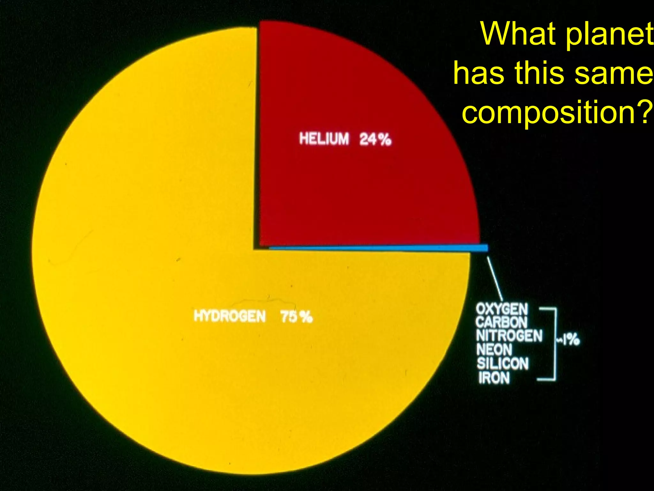
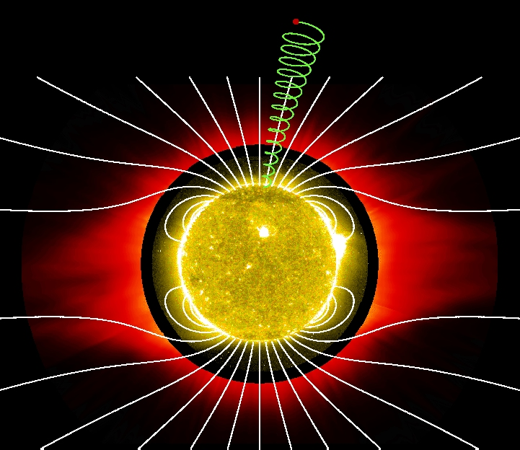
Overview of Sun
© Gerard Williger 2023 U Louisville
Mid-size/mass between smallest, largest stars, 4.5-5.8 Gyr old
Photosphere (“light disk”) T=5800K = 10,000F, midway between coolest, hottest stars
But MOST stars are smaller and cooler
92% hydrogen, 7.8% helium, 0.2% everything else (by numbers of atoms)
Has magnetic fields all over → control activity
Sun’s compo-sition

Slide 3
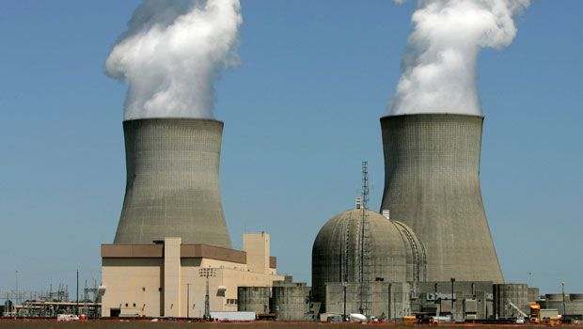

Sun’s Luminosity
© Gerard Williger 2023 U Louisville
L_{sun}=3.9x10²⁶ Watts (Joules/sec)
Earth’s worldwide power consumption/sec 2022: 6.7 Terawatts (6.7x10¹² W) (Wikipedia)
1 second of Sun’s luminosity could power civilization for 1.8 million yrs (if 100% efficient)

Slide 4
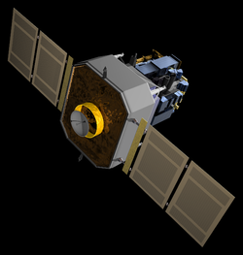
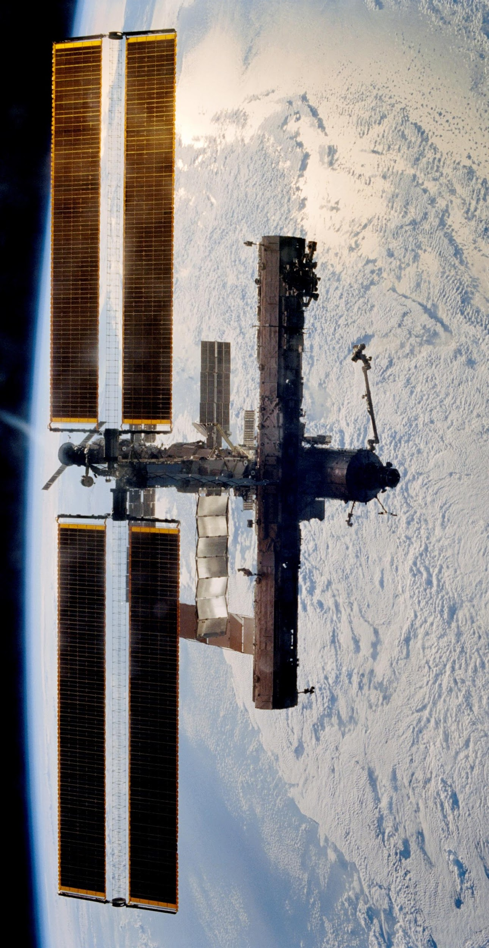
Some Satellites Studying Sun
SOHO (Solar & Heliospheric Observatory): NASA+ESA (1995-)
Hinode (`sunrise’): Japan/NASA/British (2006-), images to 175km resolution in UV to study corona and flares
STEREO A,B (Solar Terrestrial Relations Observatory): NASA (2006-)
Solar Monitoring Observatory (on Int’l Space Station): NASA (2008-)
Solar Dynamic Observatory: NASA (2011-)
Parker Solar Probe: NASA (2018-), to 10 solar radii
HiSolar Orbiter (SolO) : ESA (2020-), study solar poles from 60 solar radii
© Gerard Williger 2023 U Louisville

Slide 5
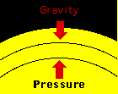
Key Concept: Gravity-Pressure balance
© Gerard Williger 2023 U Louisville
Sun in ``hydrostatic balance” between gravity pulling in and pressure from nuclear fusion in core pushing out

Slide 6
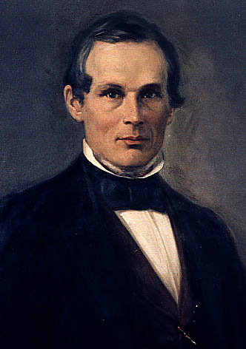
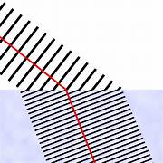
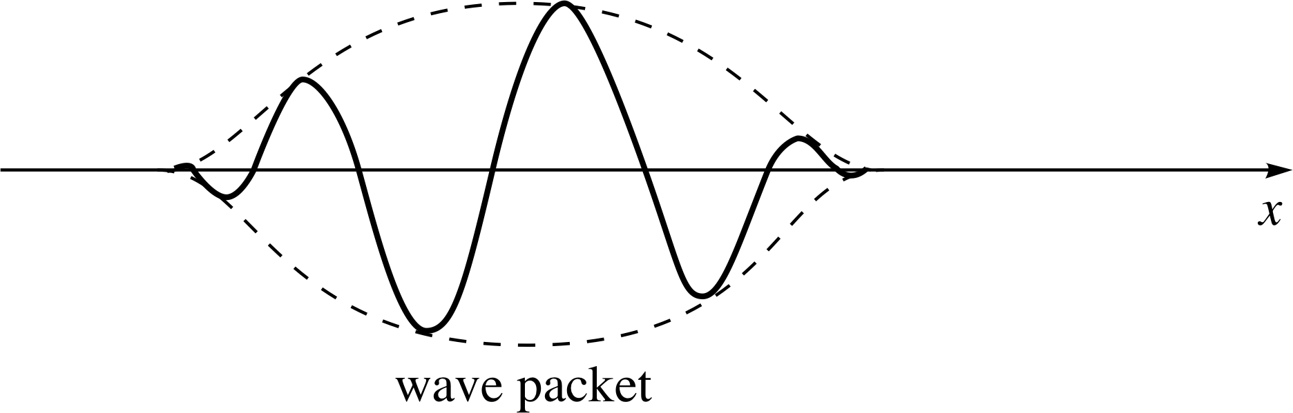
Key Concept: Light: Wave-like AND Particle-like
Anders Ångström 1814-74
© Gerard Williger 2023 U Louisville
Electromagnetic WAVE-LIKE behavior:
Refracts (bends in air, water, glass etc.)
Diffracts (spreads out going through hole)
Wavelength measured in Ångstroms (Å, also in nm, microns, mm etc.); each wavelength has a frequency
1 Å= 10⁻¹⁰ m (m=meter), = 0.1 nm, X-ray wavelength
4000-7000 Å = optical wavelengths (what your eyes see)
bacteria-sized
-- PARTICLE-LIKE behavior (think billiard balls)
Is quantized (comes in distinct packets)
Light quantum (packet) = PHOTON
Photons have ENERGY, MOMENTUM, SPIN
So light can push on things
Unlike matter, photons have ZERO MASS
Wave packet
FYI 3’ video: what are electric and magnetic waves?

Slide 7
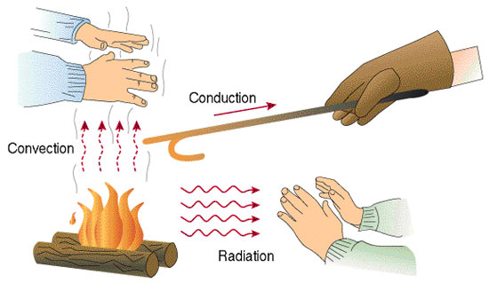
Key Concept: 3 Types Heat Transfer
© Gerard Williger 2023 U Louisville
1) Convection: moving blobs of hot material, ex. forced-air furnace moves warm air into room
2) Radiation: heating matter at a distance via high energy photons, ex. Warming your hands by a fire
3) Conduction: surface-to-surface contact between a warm and cold body, with heat transferred by molecular vibration, ex: warming your hands on a hot coffee cup

Slide 8
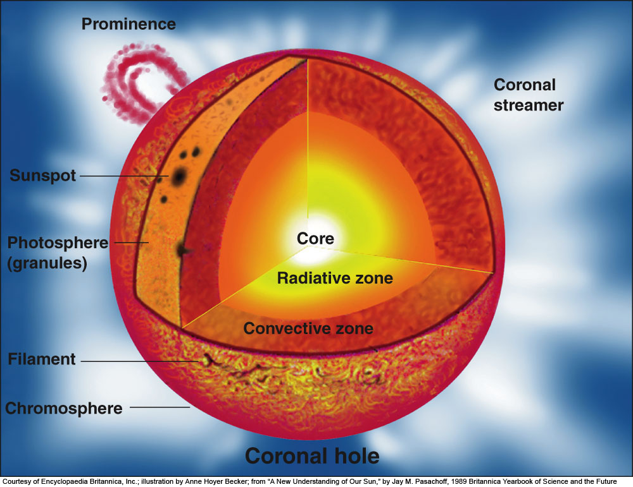
© Gerard Williger 2023 U Louisville
Notes:
Figure 10.3: The parts of the solar atmosphere and interior. The solar surface is depicted as it appears through a hydrogen filter; thus, here we actually see the chromosphere, except in the narrow sliver labeled “photosphere (granules).” The photosphere is the visible surface of the Sun.
The interior has a core, where the energy is generated, surrounded by a zone in which the dominant method of energy transfer is radiation and a zone in which convection (a “boiling” effect) dominates. On the surface, the photosphere, we find sunspots as well as loops of gas that are dark filaments when seen in projection against the disk and that are bright prominences when seen off the Sun’s edge. The chromosphere, a thin layer above the photosphere, shows best in hydrogen-light and is composed of small spikes known as spicules. The white corona above it extends far into space. Its shape, including its huge streamers, is determined by the Sun’s magnetic field. (Courtesy of Encyclopaedia Britannica, Inc.; illustration by Anne Hoyer Becker; from “A New Understanding of Our Sun,” by Jay M. Pasachoff, 1989 Britannica Yearbook of Science and the Future.)

Slide 9
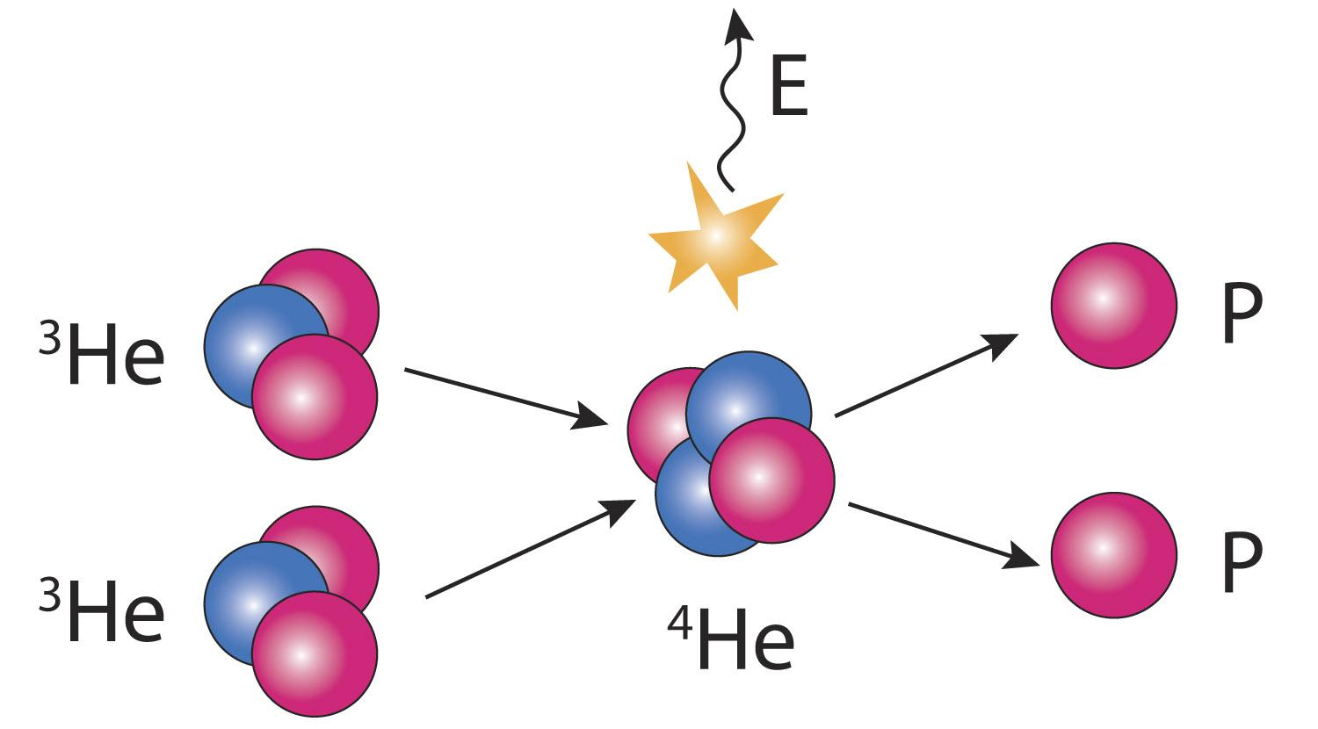
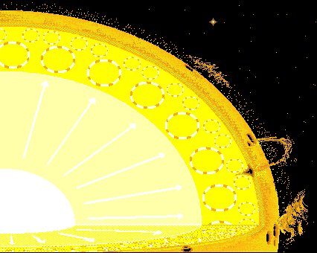
Solar Interior
© Gerard Williger 2023 U Louisville
Core: inner 25%, T~15 million Kelvin, pressure ~300 billion x Earth’s atmosphere, 14x denser than lead
Nuclear fusion: 4 hydrogens → 1 helium + energy
Radiative Zone: heat from core transferred by radiation; gas doesn’t move around
Convective Zone: Outer 30%, blobs of hot gas rise, cool gas sink to transfer heat to photosphere by convection
Fusion (last step)
Convec-tion

Slide 10
Convective Zone
© Gerard Williger 2023 U Louisville
In Sun’s core, atoms are so hot they’re ionized (no electrons)
→ don’t absorb photon energy easily. 85% of way out to “surface” from core, heavy element atoms (not hydrogen or helium, for example carbon) are cool enough to hold electrons
Heavy element held electrons absorb energy from high energy photons coming from core → heats the gas. It rises, cools, and sinks: convection

Slide 11
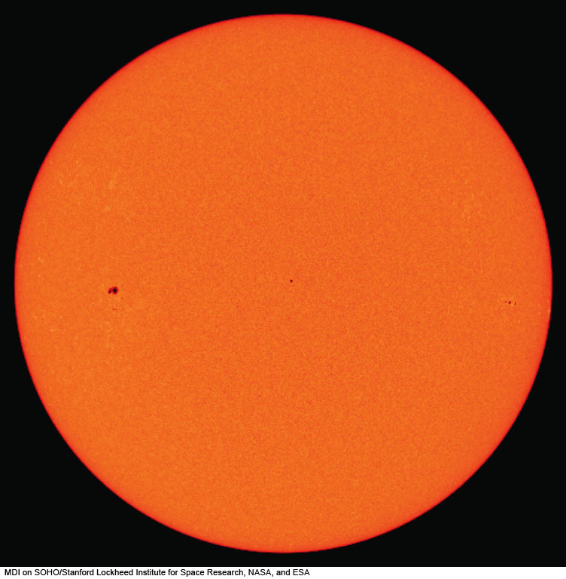
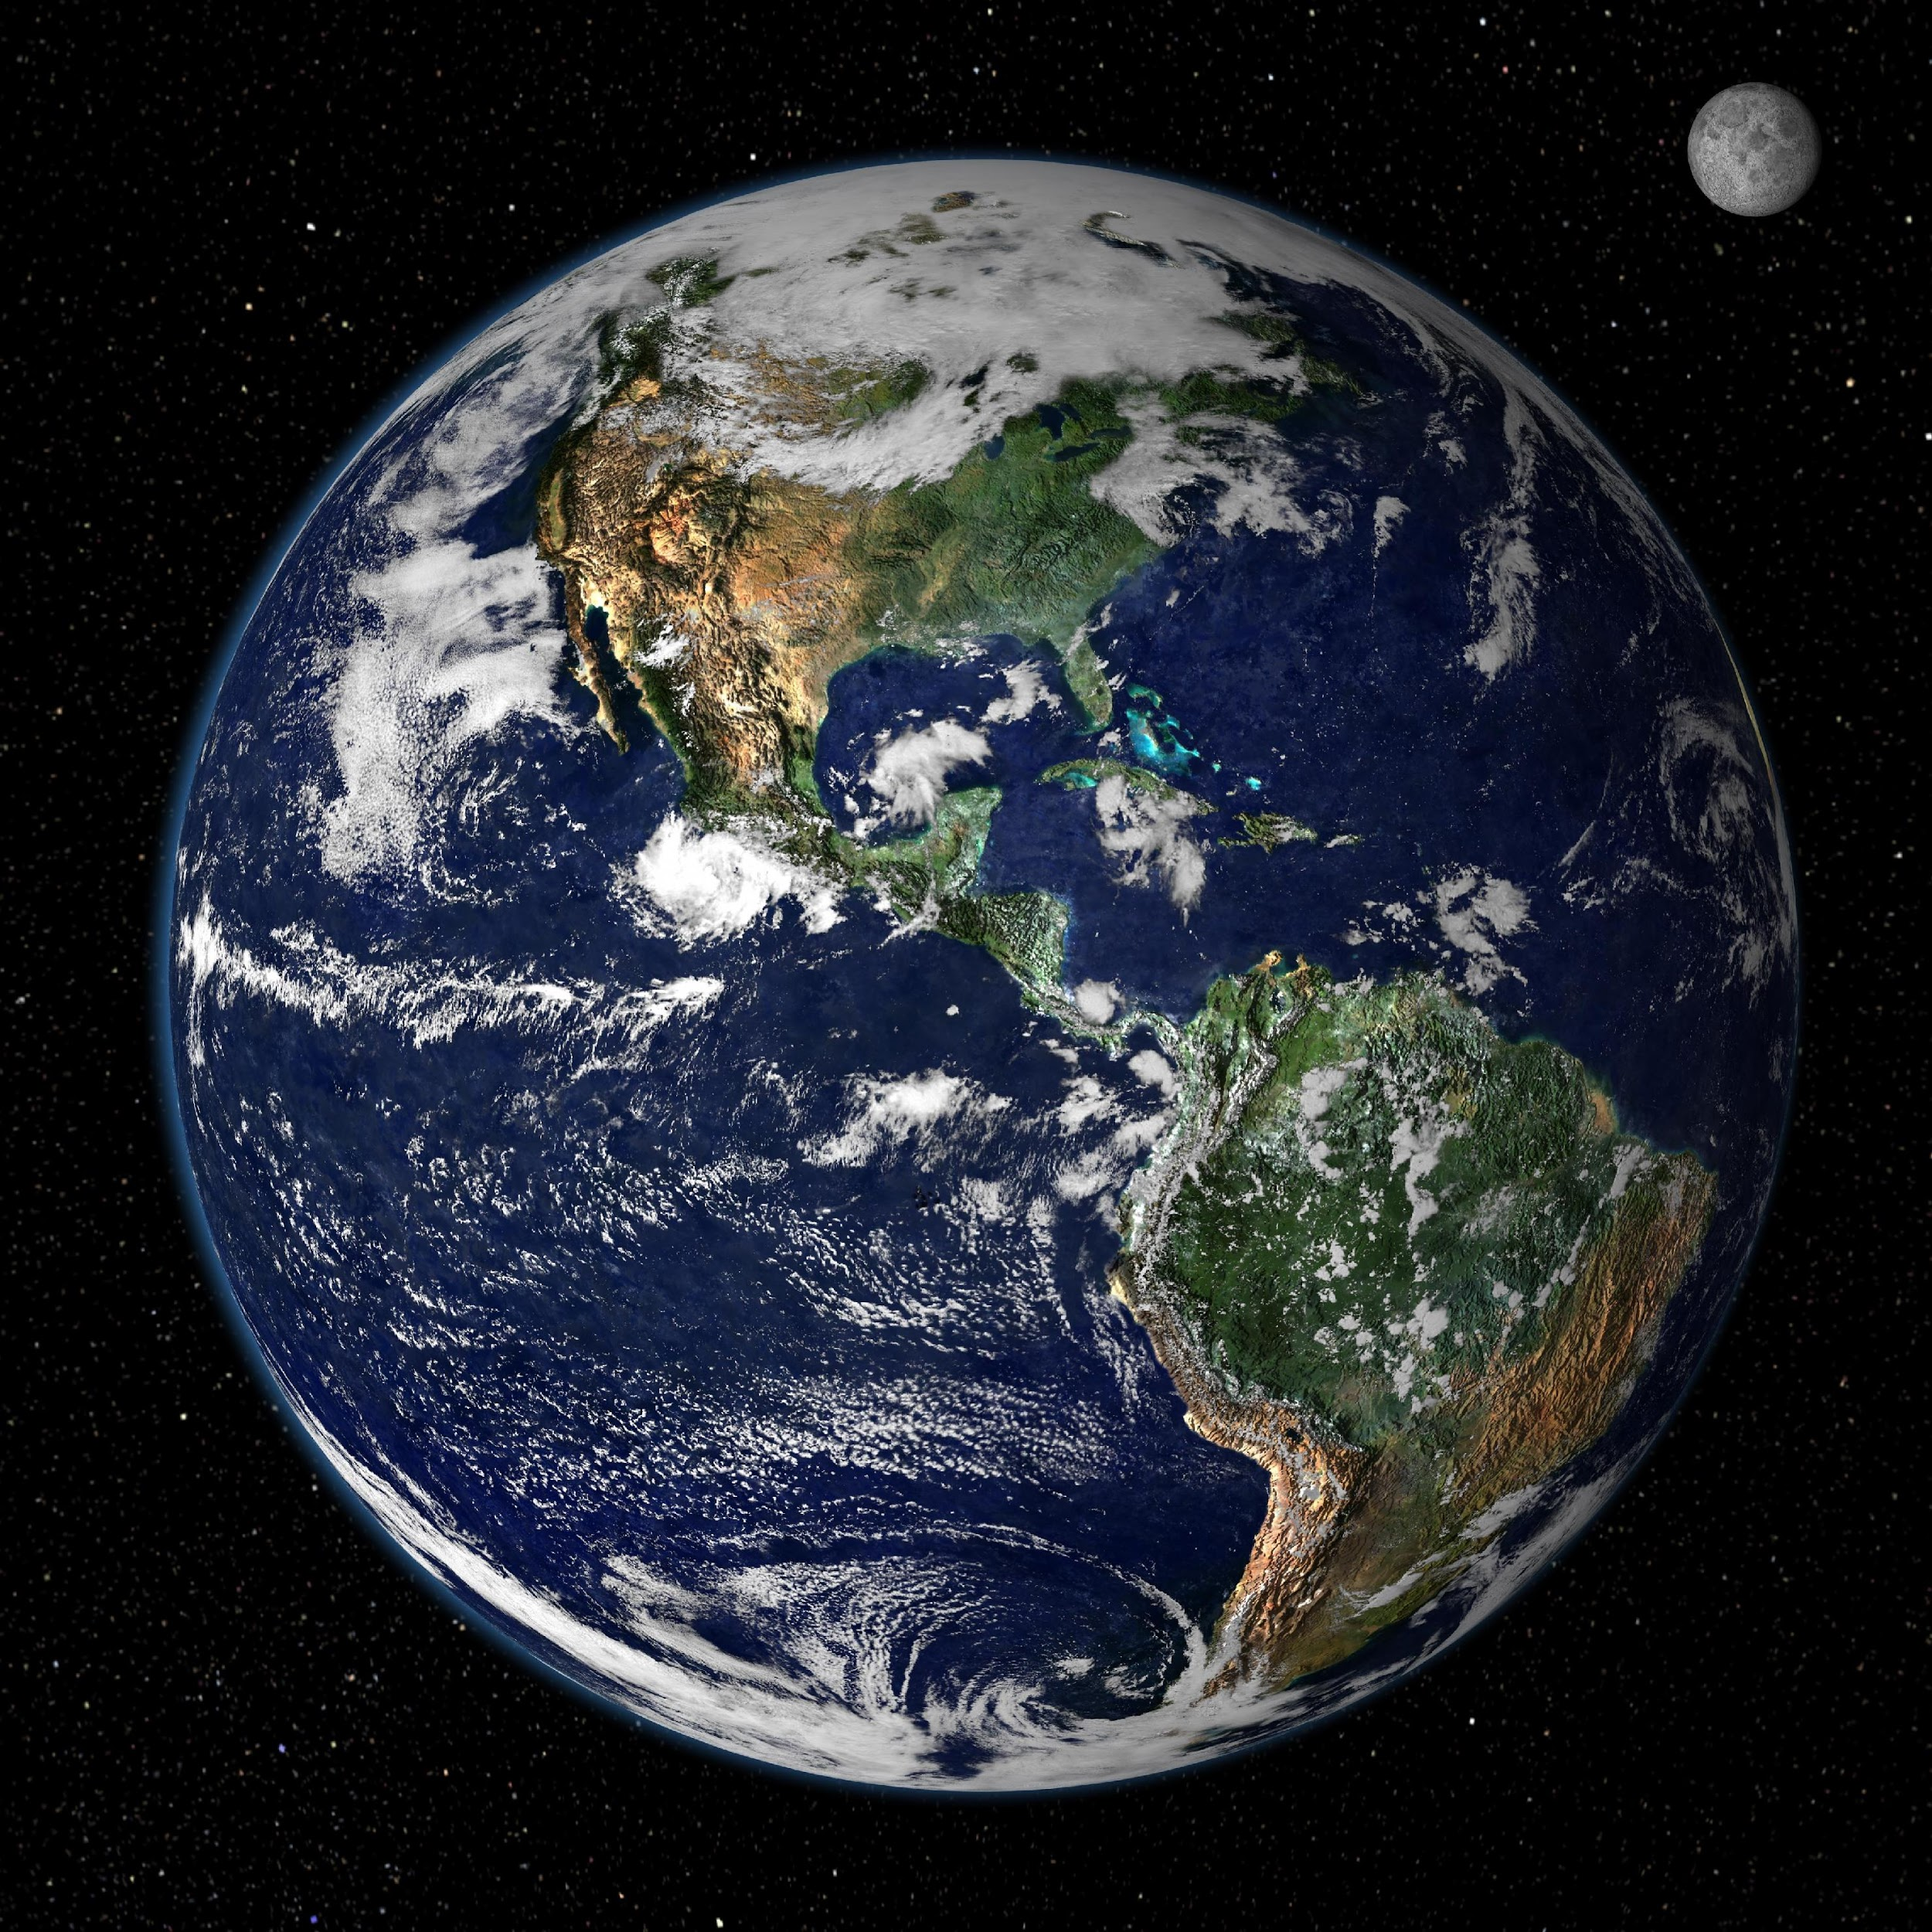
5.1 Photosphere
© Gerard Williger 2023 U Louisville
Diameter: ~110x Earth
Slightly oblate/flattened due to rotation
Shows dark sunspots (more later)
Earth
Notes:
Figure 10.2: The solar photosphere in an image taken on April 8, 2005, the day of a total eclipse.
MDI on SOHO/Stanford Lockheed Institute for Space Research, NASA, and ESA

Slide 12
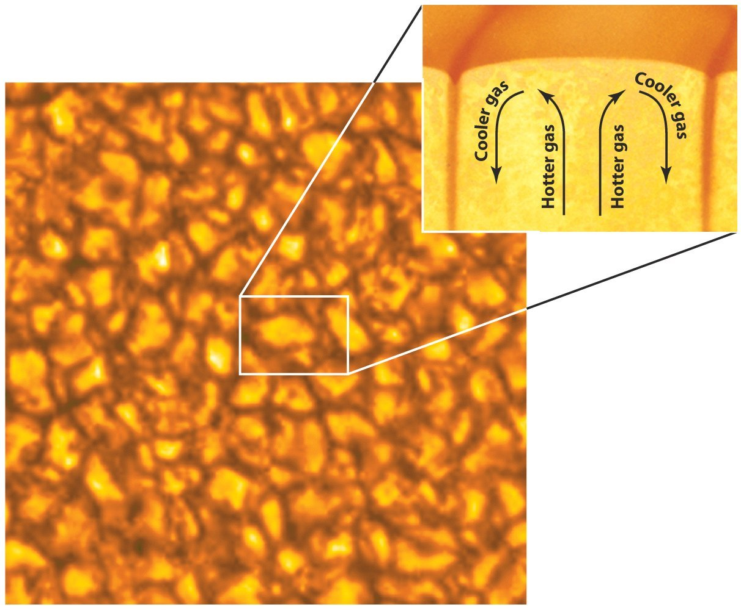
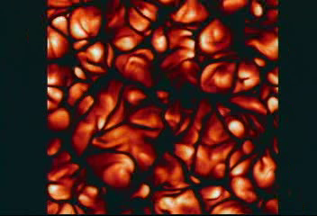
Photosphere
© Gerard Williger 2023 U Louisville
Deepest we can see into Sun
deeper is opaque
No solid surface
T~5800K = 10,000F (on average)
Gives off light of all colors
Mostly yellow light, appears yellow-white to eyes
Shows “granules” (convection cells rising, cooling then sinking)

Slide 13
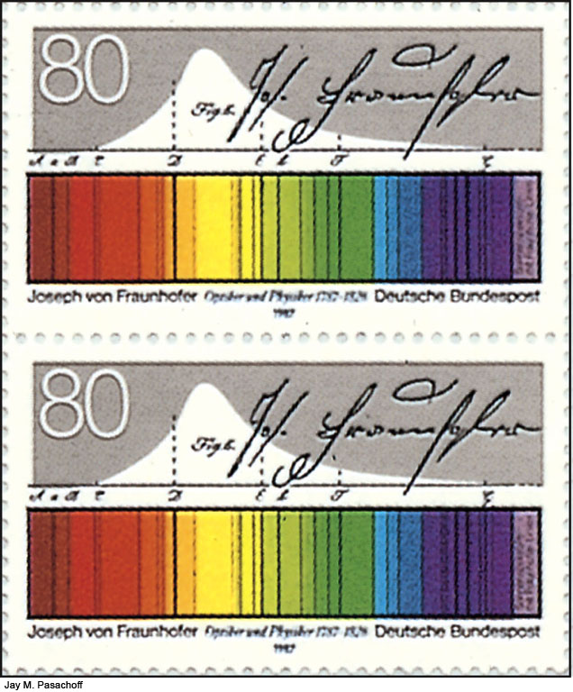
Photosphere Spectrum
© Gerard Williger 2023 U Louisville
Continuum blackbody source (all wavelengths of light)
+Many absorption lines (Fraunhofer lines)
Lines from many elements: H,He,Ca,Fe,Na etc.

Slide 14
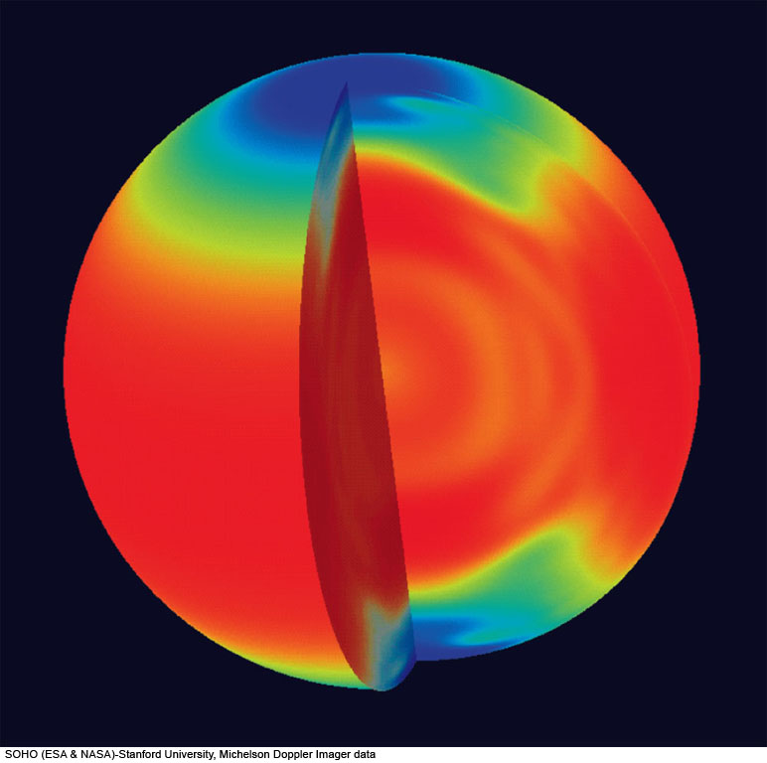
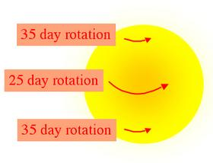
Solar Rotation
from Helioseismology (Doppler shifts) and sunspots
Photosphere+Convective Zone: Differential rotation
25 days @equator, 35 days @poles
Twists up magnetic fields 🡪 solar `dynamo’
© Gerard Williger 2023 U Louisville
Notes:
Figure 10.6: The rotation periods of different layers and regions of the Sun, based on helioseismology results, shown in false color. Measurements reveal that the surface rotation periods, which vary from 26 days at the equator to 36 days at the poles, persist inward through the solar convection zone. Further toward the center, the data show that the Sun rotates as a solid body with a 27-day period.
SOHO (ESA & NASA)-Stanford University, Michelson Doppler Imager data

Slide 15
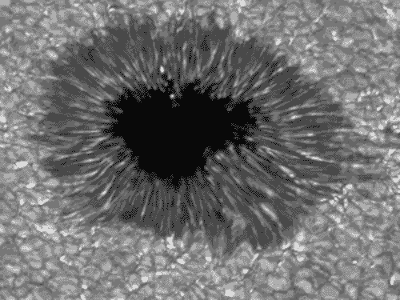
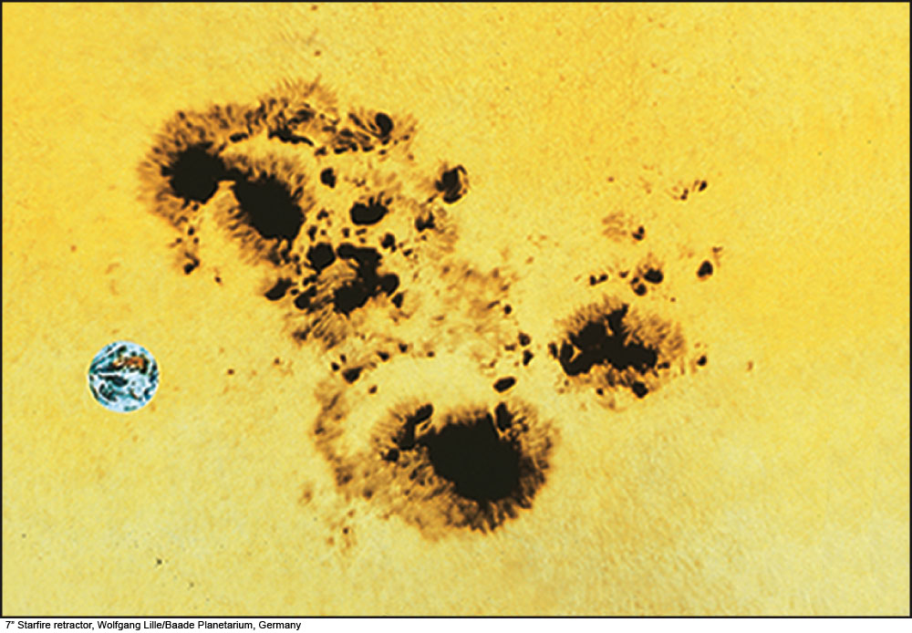
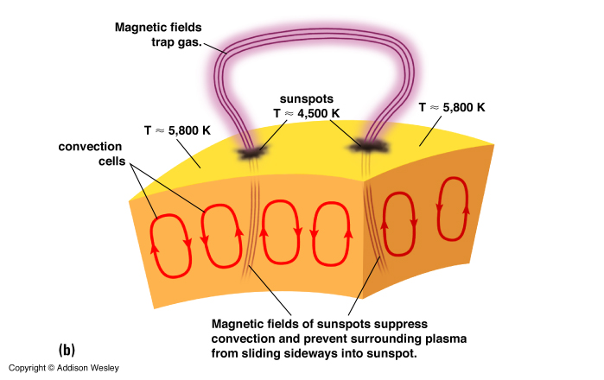
© Gerard Williger 2023 U Louisville
5.2a Sunspots
Earth
Umbra
Penumbra
Magnetic fields of sunspots suppress convection 🡪 hot gas (plasma) just stays and cools
Notes:
Figure 10.16: A sunspot group, showing the dark umbra surrounded by the lighter penumbra for different spots in the group. A photo of the Earth is superimposed to show its relative size.
7” Starfire retractor, Wolfgang Lille/Baade Planetarium, Germany

Slide 16
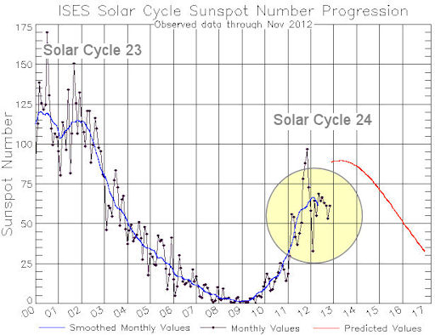
Sunspots
© Gerard Williger 2023 U Louisville
Publicized by Galileo; observed by Chinese before telescopes
T~3800K (cool!) so appear DARK against Sun
Can last for >1 month, occur in groups
Appear where magnetic field is STRONG
>~10,000x stronger around Sunspots than Earth’s mag field (or ~10x average for Sun)
Occur in pairs: north and south magnetic polarity

Slide 17
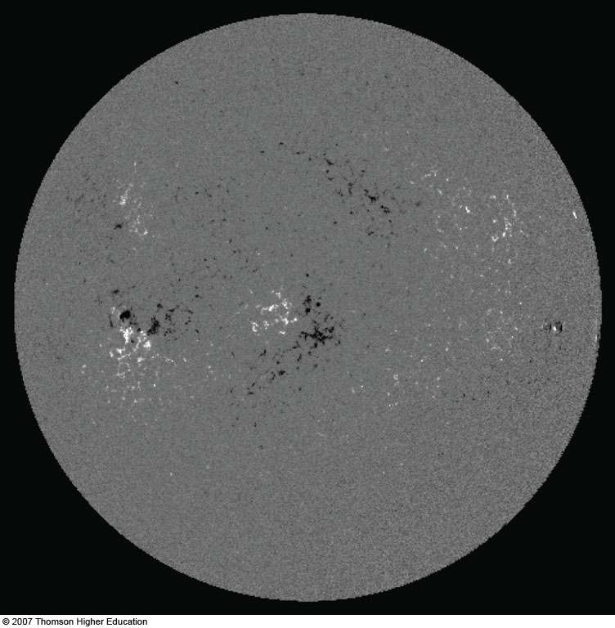
Magnetic Field of the Sun
© Gerard Williger 2023 U Louisville
Opposite magnetic polarities
Notes:
Figure 10.17b: The magnetic field of the Sun on April 8, 2005, the day of an eclipse, to match earlier solar images in this chapter. Black and white, respectively, show opposite polarities. Compare with the sunspot diagram of Figure 10-2.

Slide 18
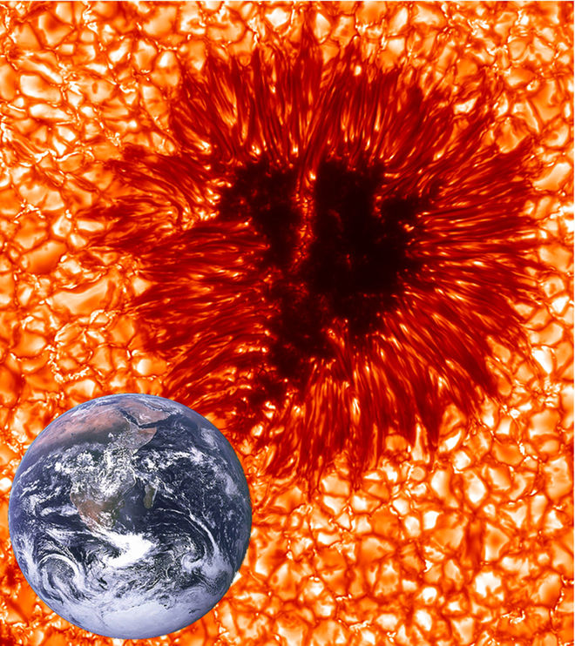
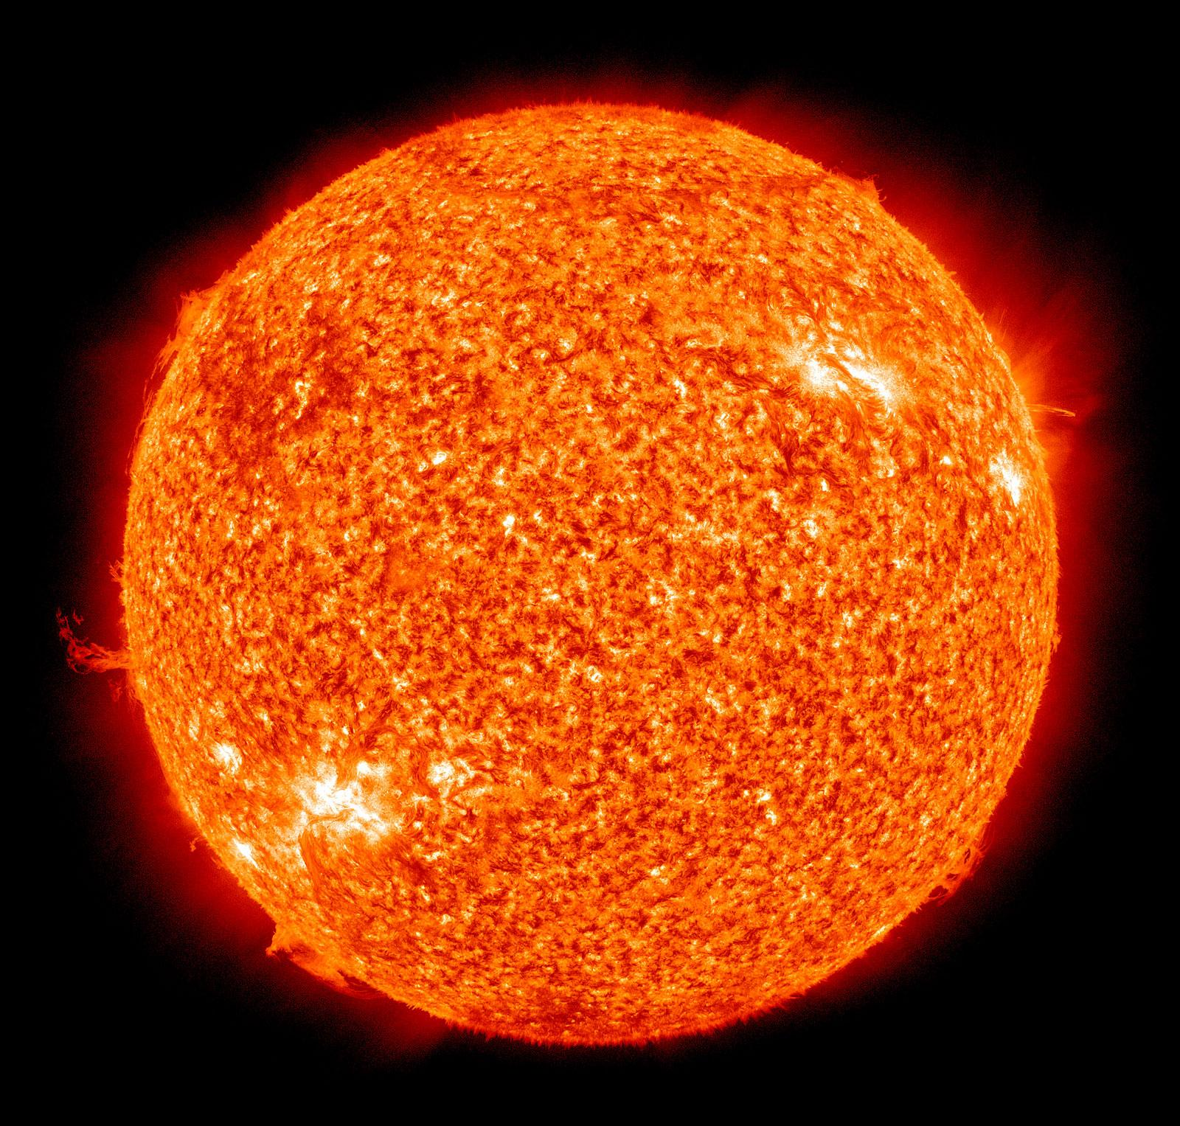
How Sunspots Work
© Gerard Williger 2023 U Louisville
Charged particles (all of Sun) move along magnetic field lines
Strong mag field lines keep hot material from coming up from solar interior
Sunspot areas radiate away heat, cool off
Stay @same latitude where `born’, rotate with Sun
Reach maximum numbers every 11 years
Related to twisting of mag fields over time
Mag polarity reverses after 11 yrs; whole cycle 22 yrs
Next maximum 2023-2024 – during eclipse!
Sun gets ~0.1-0.2% brighter during sunspot max! (Reason: many little bright areas called faculae in photosphere more than make up for sunspots.)
NASA-SOHO

Slide 19
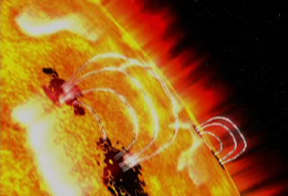
Sunspot Formation & Flare
© Gerard Williger 2023 U Louisville

Slide 20
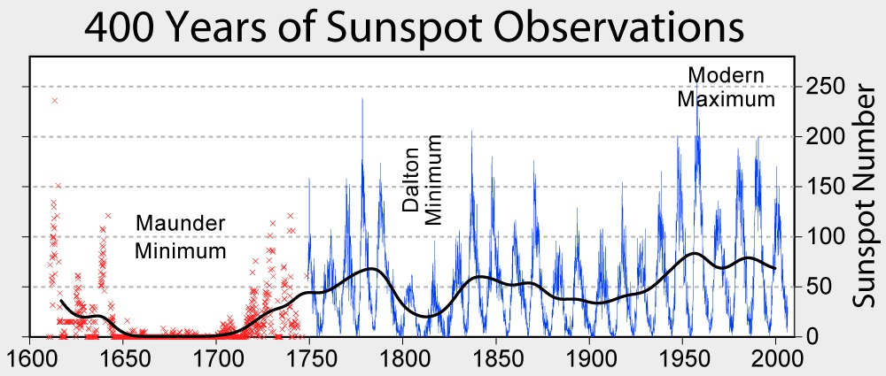
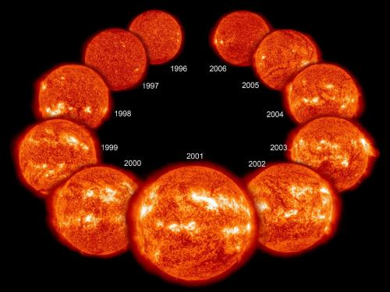
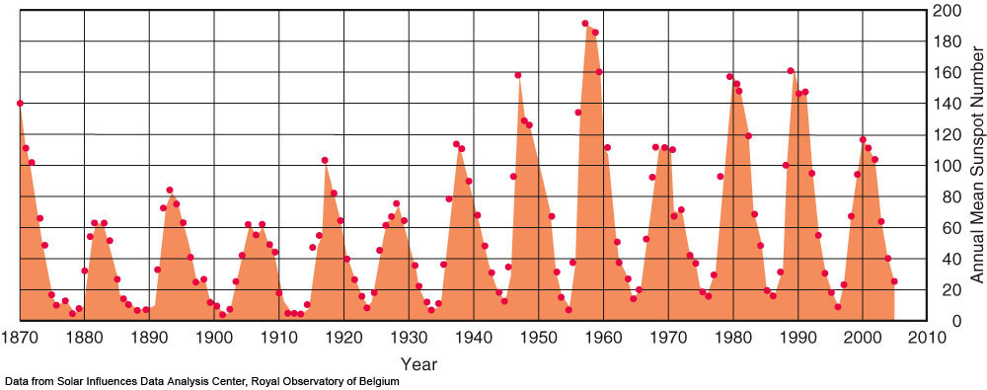
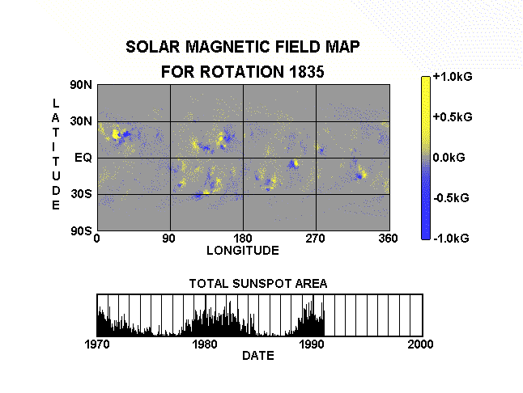
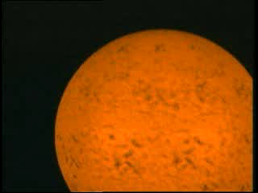
5.2b.1 Solar Dynamo: winding magnetic field and sunspot numbers
Little Ice Age
Cooling
150 yrs
© Gerard Williger 2023 U Louisville
Notes:
Figure 10.18: The 11-year sunspot cycle is but one manifestation of the solar-activity cycle. (Data from Solar Influences Data Analysis Center, Royal Observatory of Belgium)

Slide 21
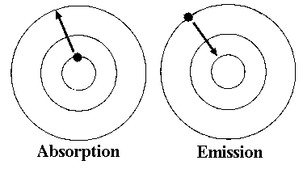
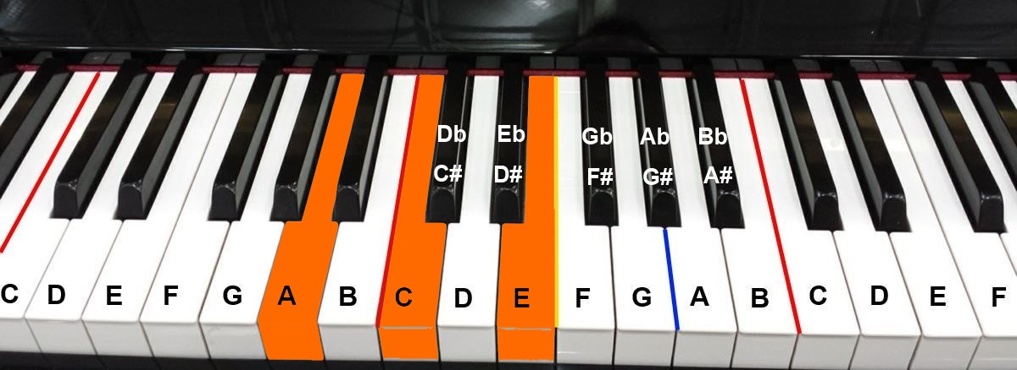
Key Concept: Atoms absorb/emit light
© Gerard Williger 2023 U Louisville
Electrons in atoms have discrete energy levels
Electrons moving UP - absorb photons of certain wavelengths
Electrons moving DOWN - emit photons of certain wavelengths
Similar to of sets of notes on a piano

Slide 22
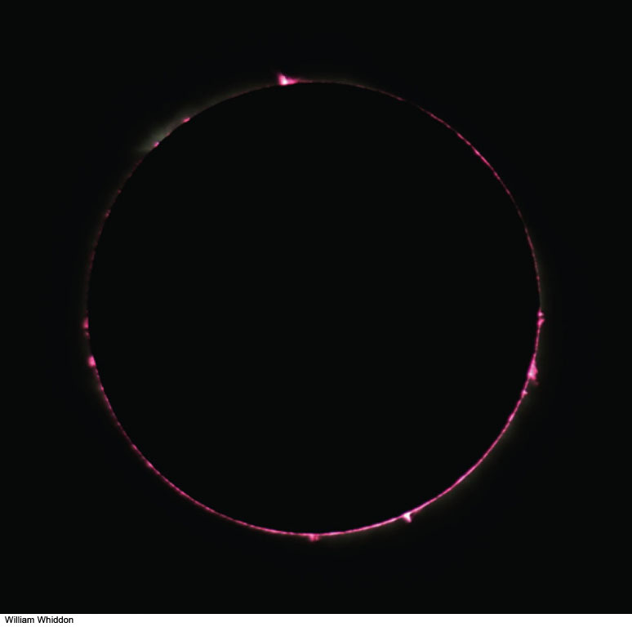
© Gerard Williger 2023 U Louisville
Chromosphere
Bright+opaque in red "hydrogen-alpha light” (emission lines)
Above photosphere
Few x1000 km deep (= thin layer!)
T~7,000-15,000K = 13,000-27,000F
Led to discovery of helium
Well-observed during eclipses
1.8’ Video FYI: emission, absorption and continuum spectra
Notes:
Figure 10.4a: The chromosphere of the Sun, photographed during the total solar eclipse of April 8, 2005. Notice how pink it looks.
William Whiddon

Slide 23
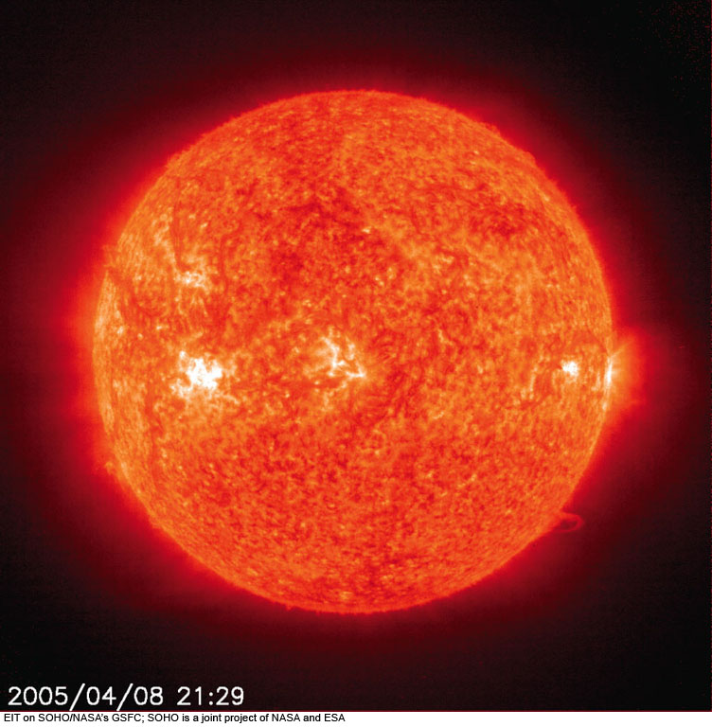
Chromosphere
© Gerard Williger 2023 U Louisville
Photographed in light of singly ionized helium
Sunspot in photosphere, bright spot in chromosphere
Notes:
Figure 10.9: A set of images taken almost simultaneously through the four filters of the Extreme-ultraviolet Imaging Telescope (EIT) on the Solar and Heliospheric Observatory (SOHO) in space. These images were taken at the same time a total solar eclipse was observed, at about Universal Time 2100 on April 8, 2005.
(a) Ionized helium gas at a temperature of about 60,000 K, with a small contribution from ionized silicon. This wavelength shows the chromosphere.
EIT on SOHO/NASA’s GSFC; SOHO is a joint project of NASA and ESA

Slide 24
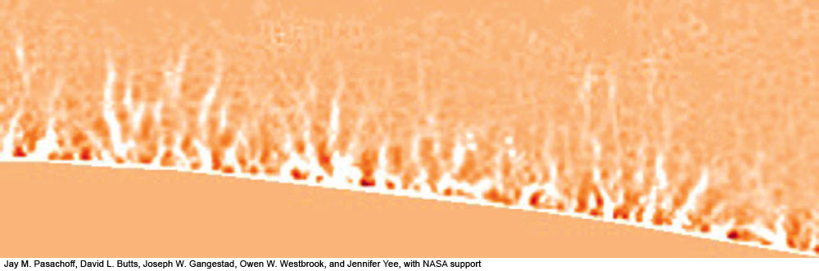
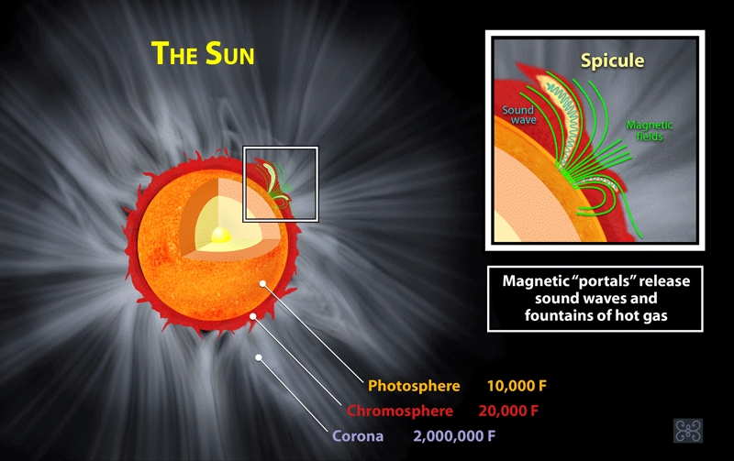
Spicules In Chromosphere
Spicules in Chromosphere
700km wide x 7000 km tall (same size as granules)
Jets ejected into chromosphere from photosphere
Last for 5-15 minutes
Half million at any time
Transition region
© Gerard Williger 2023 U Louisville
Notes:
Figure 10.8b: A high-resolution image of the Sun, showing spicules, taken by one of the authors (J.M.P.) and his students with the Swedish Solar Telescope in the Canary Islands.
Jay M. Pasachoff, David L. Butts, Joseph W. Gangestad, Owen W. Westbrook, and Jennifer Yee, with NASA support

Slide 25
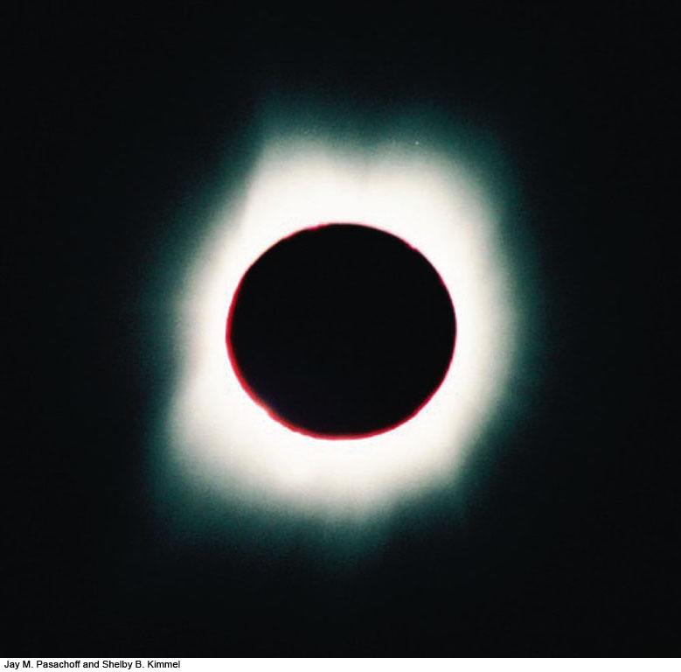
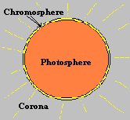
5.2b.2 Corona: Sun’s Atmosphere
© Gerard Williger 2023 U Louisville
Inner Corona
Very hot: 1-2 million Kelvin = 2-4 million F
Very low density: 1/10 billionth of air → FAINT (normally only visible from Earth during eclipses)
Heated by magnetic fields from below
Magnetic fields “crack the whip” in ionized gas
Low density → gets hot by absorbing even a little energy
Corona is powerful X-ray source
3.5’ video – coronal heating
Corona expands throughout solar system
→ produces solar wind -- 0.01 trillionth of sun’s mass/yr
15” Audio: sound of solar wind, from Parker Solar Probe

Slide 26
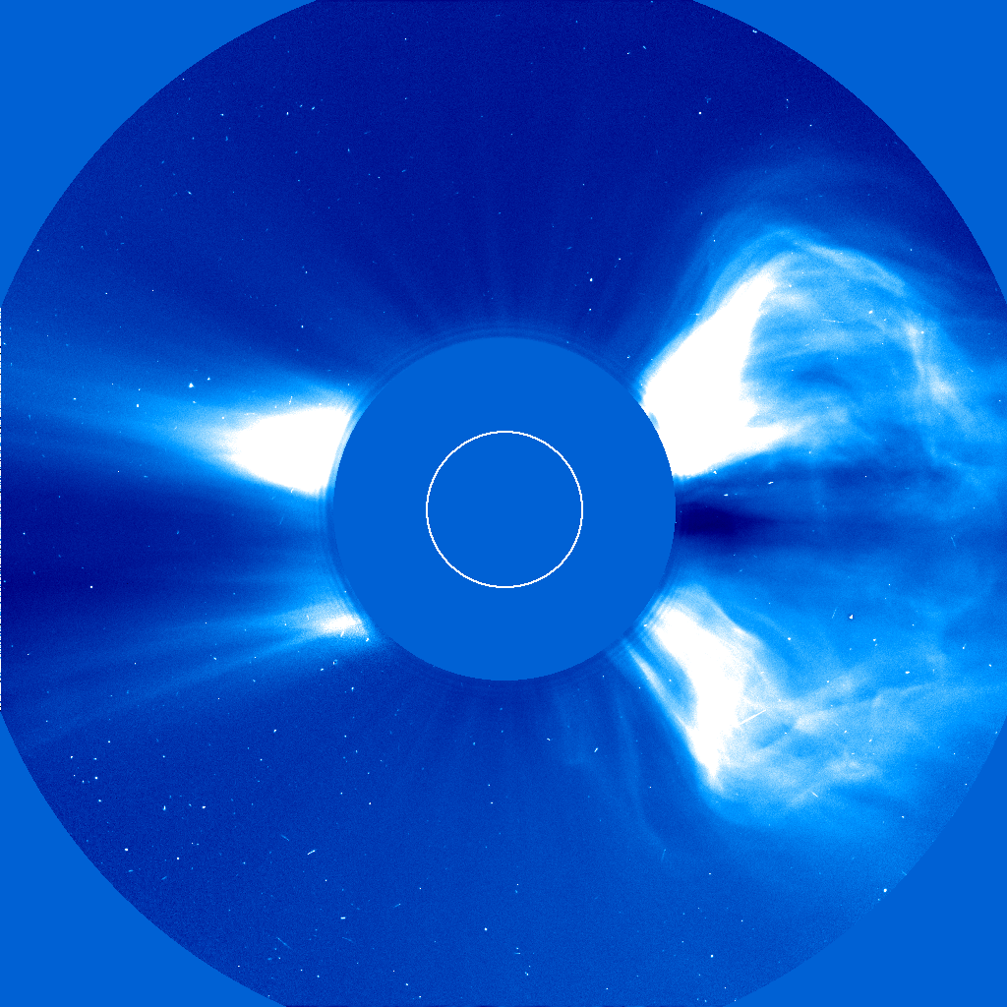
Form of Corona - VARIABLE
© Gerard Williger 2023 U Louisville
Holes: over poles, other places
Streamers: over equator
Loops of gas: follow magnetic fields
Studied during eclipses or by satellites with a coronagraph
blocks out photosphere, lets us observe faint corona
Coronal Mass Ejections (CMEs)
Explosions in corona, release particles into solar wind; some knock out power/satellites on Earth, ~1/day

Slide 27
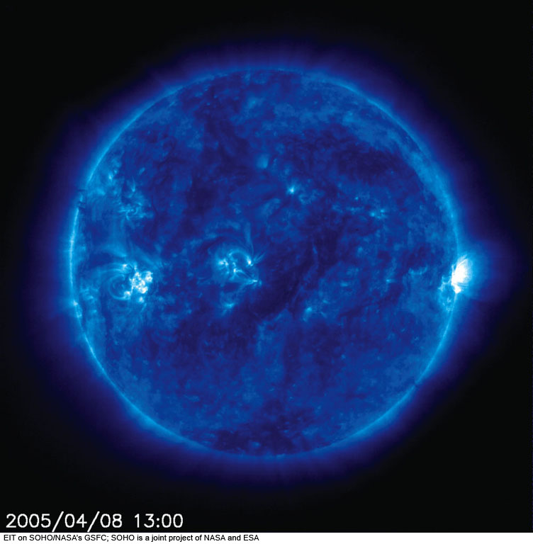
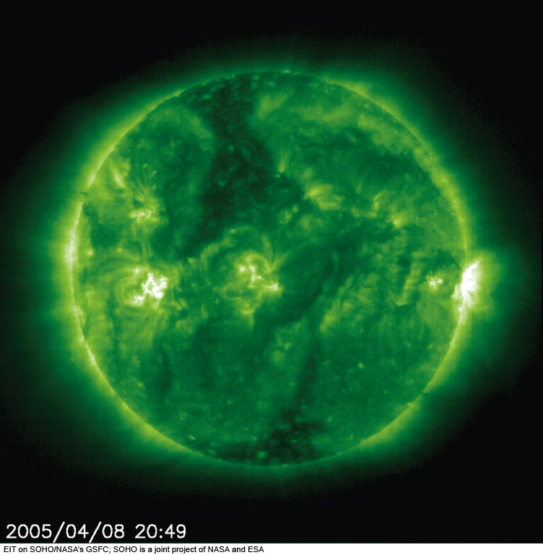
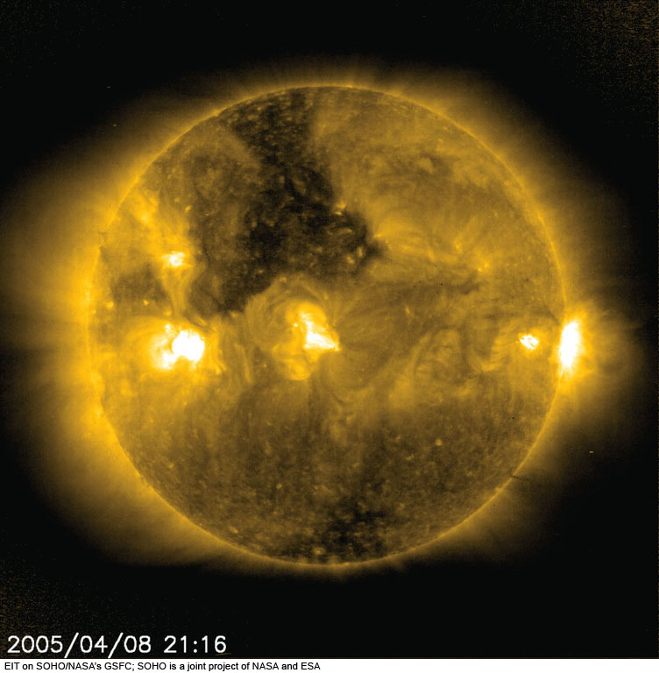
Corona at different temperatures and X-ray wavelengths
© Gerard Williger 2023 U Louisville
Corona at 1 million K (ionized Fe emission)
Corona at 1.5 million K (ionized Fe emission)
Corona at 2 million K (ionized Fe emission)
Notes:
Figure 10.9: A set of images taken almost simultaneously through the four filters of the Extreme-ultraviolet Imaging Telescope (EIT) on the Solar and Heliospheric Observatory (SOHO) in space. These images were taken at the same time a total solar eclipse was observed, at about Universal Time 2100 on April 8, 2005.
(b) Ionized iron at a temperature of about 1,000,000 K.
EIT on SOHO/NASA’s GSFC; SOHO is a joint project of NASA and ESA

Slide 28
5.2c Flares & Coronal Mass Ejections: “Space Weather”
© Gerard Williger 2023 U Louisville
Flare: magnetically driven release of mostly photons (X-rays etc.), takes 8 minutes to reach Earth
CME: magnetically driven release of mostly charged particles, takes 2-3 days to reach Earth
They can start together!
-- Can knock out satellites and power grids
1.7’ video FYI

Slide 29
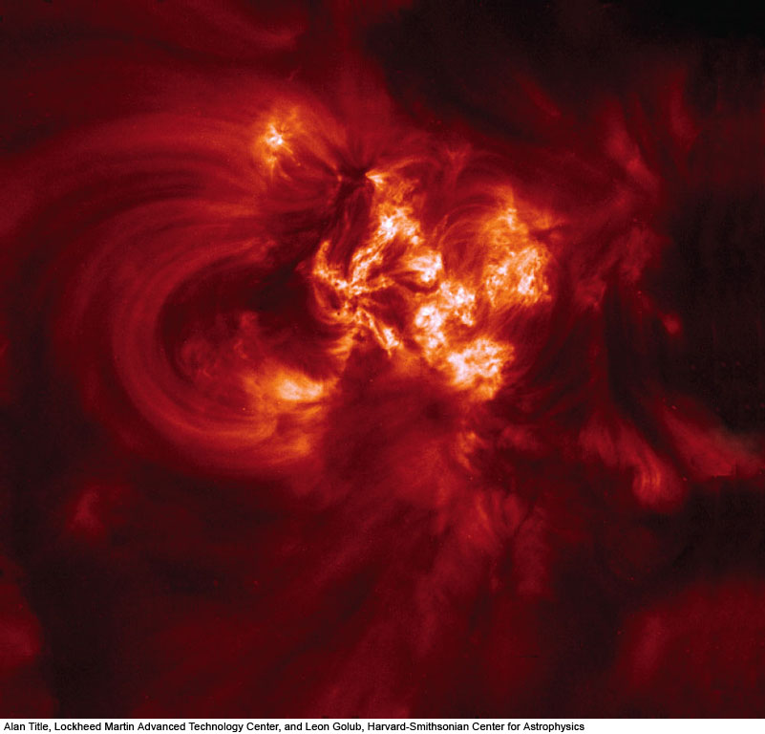
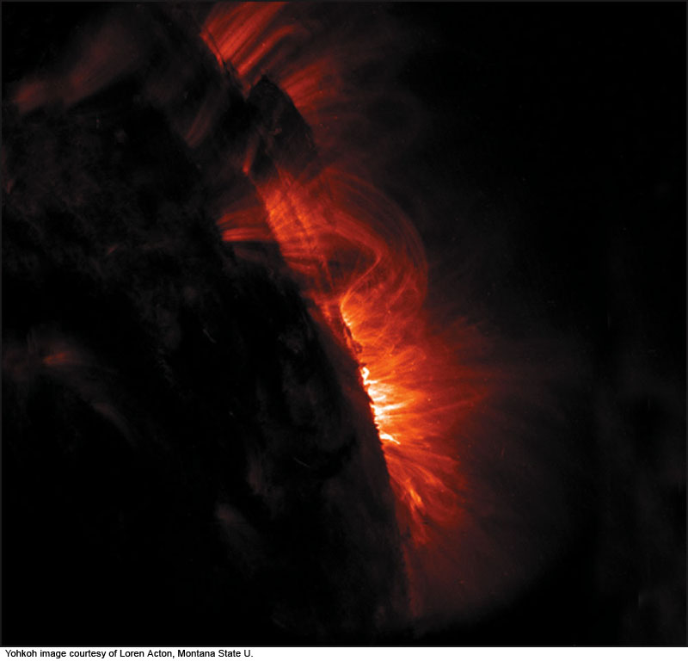
From TRACE satellite, ultraviolet wavelengths
© Gerard Williger 2023 U Louisville
Small Coronal Loops
Giant Coronal Loops
From TRACE satellite, ultraviolet wavelengths)
Notes:
Figure 10.15: An ultraviolet image, taken from space on the day of the April 8, 2005, total solar eclipse, shows small coronal loops. The image was made with the TRACE spacecraft. The expeditions of one of the authors (J.M.P.) observed such loops from the ground during the eclipse, with lower spatial resolution but higher time resolution.
Yohkoh image courtesy of Loren Acton, Montana State U.

Slide 30
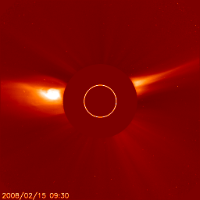
Coronal activity Feb 2008 SOHO (uses coronagraph) – space.com
© Gerard Williger 2023 U Louisville

Slide 31
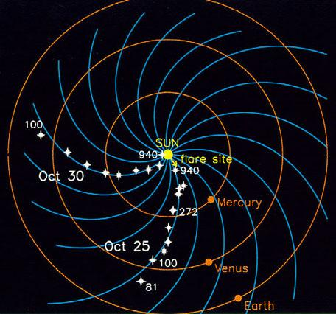
a
Corona expands throughout solar system, follows magnetic field lines, → twists up due to solar rotation, becomes
solar wind
MASS LOSS: ~10⁻¹⁴ Msun/yr
© Gerard Williger 2023 U Louisville
Twisted Solar Magnetic Field

Slide 32


Solar Weather
© Gerard Williger 2023 U Louisville
Flares: giant/bright eruptions of radiation, arising in `active regions' (sunspots etc. – anything caused by magnetic disturbances) – make auroras
Can knock out power/satellites (Quebec Blackout 1989); cause big aurorae; dangerous to astronauts
Cause unknown! (Hinode satellite to study them)
Probably related to magnetic reconnection: twisted mag field lines `snap’ and come together again
Aurora

Slide 33

Coronal Mass Ejections (CMEs)
© Gerard Williger 2023 U Louisville
Giant ejections of material, maybe related to flares, caused by magnetic disturbances, hits Earth’s magnetosphere, causes aurorae

Slide 34

5.2d Filaments & Prominences
© Gerard Williger 2023 U Louisville
Elongated thread of COOL gas in chromosphere, see in Hα at λ=6563Ǻ (Angstroms):
Against Sun’s disk: DARK Filaments 10⁵ km across (7% of Sun’s diameter)
Against Sun’s limb (edge): BRIGHT Prominences: Ejected loops of chromospheric material – glow at Hα wavelength
Held in place by magnetic fields

Slide 35




Filaments
Prominence
Polar crown filament, shows connection to prominence, Solar Dynamics Observatory 2013 Mar 31 – Apr 1
© Gerard Williger 2023 U Louisville
Notes:
Figure 10.8a: The Sun, photographed in hydrogen radiation, shows bright areas called plages and dark filaments around the many sunspot regions. We see an image from April 8, 2005, the day of a total eclipse.
Big Bear Solar Observatory/New Jersey Institute of Technology

Slide 36

Prominence Eruption
© Gerard Williger 2023 U Louisville
1.1’ video - prominences
Notes:
Figure 10.8a: The Sun, photographed in hydrogen radiation, shows bright areas called plages and dark filaments around the many sunspot regions. We see an image from April 8, 2005, the day of a total eclipse.
Big Bear Solar Observatory/New Jersey Institute of Technology

Slide 37

Solar Flare and CME
© Gerard Williger 2023 U Louisville
Coronal Mass Ejection (CME): Giant ejections of material, maybe related to flares, caused by magnetic disturbances, hits Earth’s magnetosphere, causes aurorae

Slide 38
Summary
© Gerard Williger 2023 U Louisville
Solar structure/layers
How we study Sun (at various wavelengths, with coronagraphs, helioseismology with Doppler shifts)
Phenomena generated by magnetic fields
Eclipses help us observe chromosphere + corona

